Slide 1
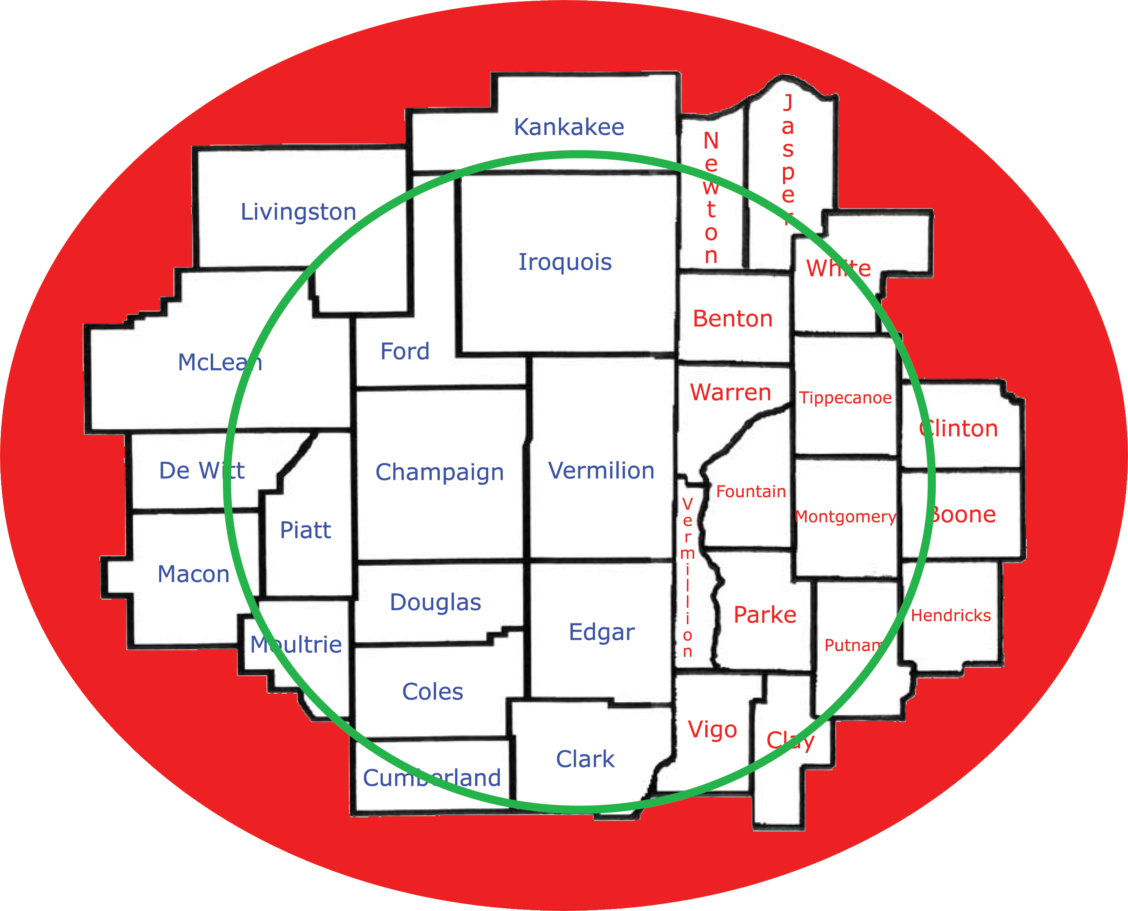
GET TO KNOW WYXY CLASSIC
Great classic country songs that you know and love from the 90’s with 70’s, 80’s and 2000’s in the mix. It’s Kenny Rogers, Dolly Parton, Alan Jackson, George Strait, Johnny Cash, Garth Brooks, Reba McEntire, Merle Haggard, and Toby Keith. All the real country legends you know and love!
This format appeals to Adults 35-64 and specifically targets 45–54-year-olds. Additionally, we reach rural lifestyle listeners and a huge farming community. They’ve been very loyal listeners since day one!
WYXY Classic 99.1 is the region’s premier station for farm and agricultural news. We are a National Association Of Farm Broadcasters (NAFB) accredited member.
Gale Cunningham is the NAFB Farm Director for WYXY. He has over 25 years in the farm related credit industry and over a decade as a farm broadcaster! Gale and WYXY Classic provide 20 agriculture reports throughout the day.
WYXY Classic 99.1 FM broadcasts with 50,000 watts of power from a tower height of 550’ located in Oakwood, IL. We have a clear, strong signal covering over fourteen counties from western Indiana to central Illinois and just south of Kankakee to Effingham. Well over 65 miles in all directions from Champaign. This station provides by far the largest coverage of any radio station in the region!

