Slide 1



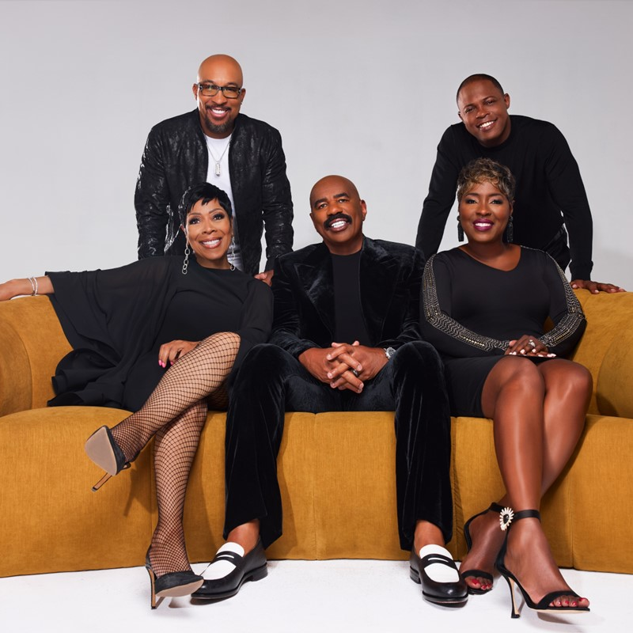

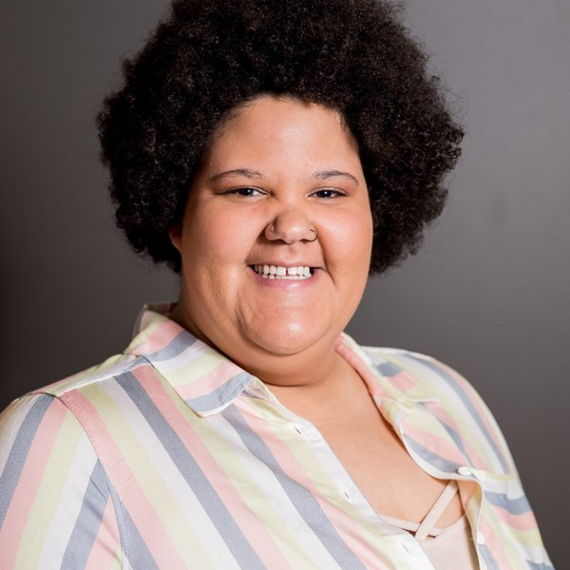



97.9 The Vibe Lineup
97.9 The Vibe is Chambana’s Home for R&B And Old School!!
M-F 6a-10a
The Steve Harvey Morning Show
Our listeners are household decision makers in their peak transitory years!
M-F Middays
Motown
61%
74%
22%
More likely than the market average to purchase a home in the next year
More likely than the market average to purchase or lease a midsize car in the next year
Plan to go back to school in the next year
M-F 3-7p
Callie
M-F 7p-12a
The Sweat Hotel
42%
One+ children (<18)
Age Breakdown
Sat 6a-10a
The Steve Harvey Morning Show
42%
Have four+ in the household
29%
Sun 6a-10a
Gospel
Earn $50,000+
INSIGHTS BY FuturiTopLine.com
CHAMPAIGN/SPRINGFIELD; SCB. MID-TIER: SP22/SP23; TSA; African American A18+; Urban format; M-Su 6a-12m;
Target Persons %; Target Index vs. Market Average of 100. Copyright © 2024 Futuri Media LLC, TOPLINE. All Rights Reserved

