Slide 1
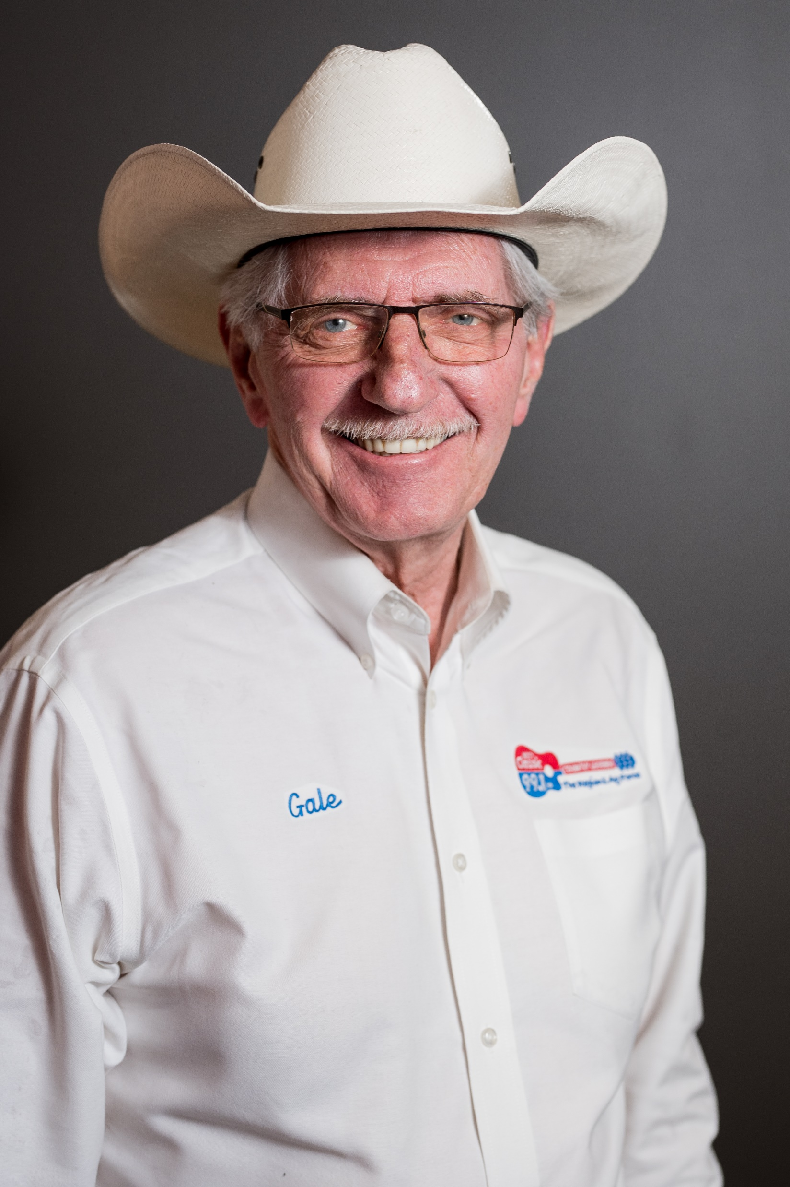
Gale Cunningham, NAFB Farm Director for WYXY Classic 99.1FM, brings his passion for the agricultural community every day. His love for agriculture began as a child growing up on a grain and dairy farm northeast of Hoopeston, Illinois. Gale’s commitment to bringing a positive agriculture message and his dedication to informing and educating can be heard in his broadcasts.
5:15am RFD Livestock Report | 5:45am Cash Grains Markets | 6:15am Ag News | 6:50am Overnight Markets
7:15am RFD Inside Ag | 7:45am Ag Program | 8:15am RFD Morning Ag News | 8:50am Opening Markets
9:50 AM Market | 10:50 AM Market | 11:50 AM Market | 12:02pm Ag Weather
12:15pm Ag Report | 12:30 Ag Report | 12:45 Ag Report | 12:55pm Ag Report
1:40pm Closing Market | 1:50 pm Market Chat | 2:50 pm Ag Wrap

